Slide 1





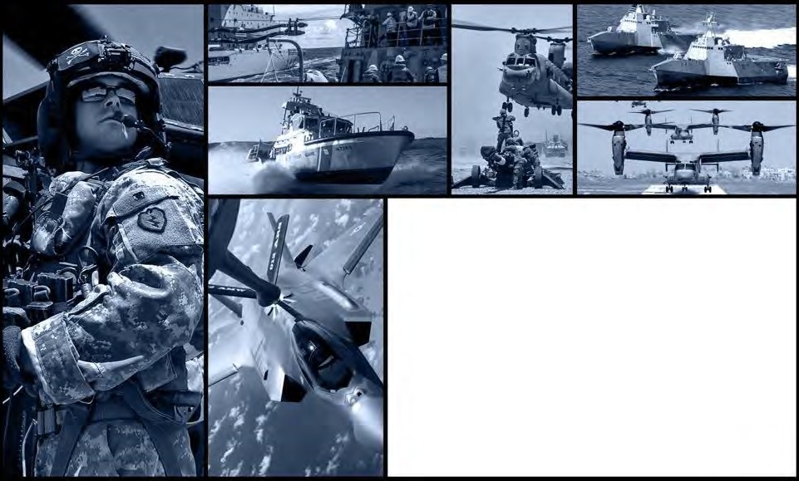
DEFENSE LOGISTICS AGENCY
AMERICA’S COMBAT LOGISTICS SUPPORT AGENCY
New WebFLIS
Access
July 20, 2015

Slide 2


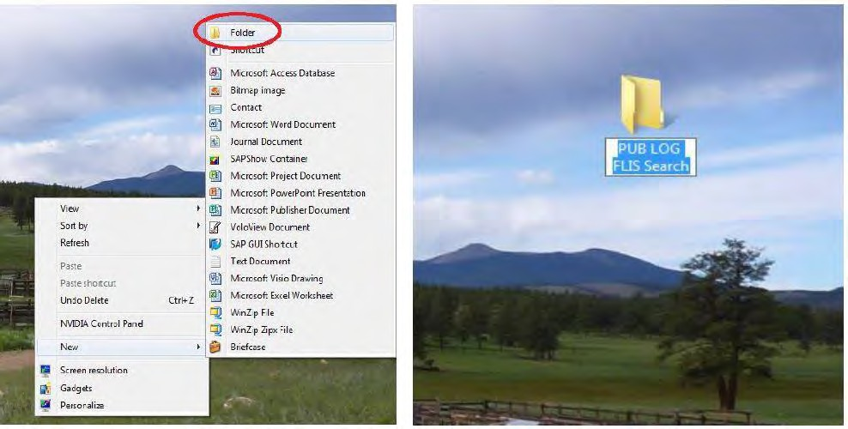
New WebFLIS Access
Create a New folder on your desk top
Deliver the right solution on time, every time
2. Label the folder “Pub Log FLIS
Search
1. Right click on your Desk Top, then click on New and then Folder

Slide 3
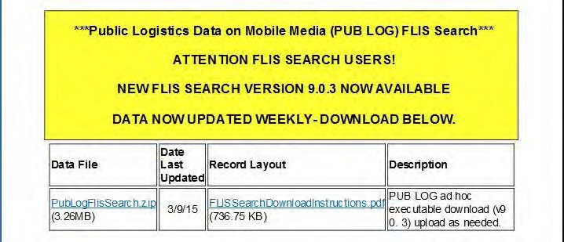
New WebFLIS Access
Deliver the right solution on time, every time
Go to the following site: http://www.logisticsinformationservice.dla.mil/foia/foia_reading.aspx
Scroll down and click on “PubLogFlisSearch.zip”

Slide 4
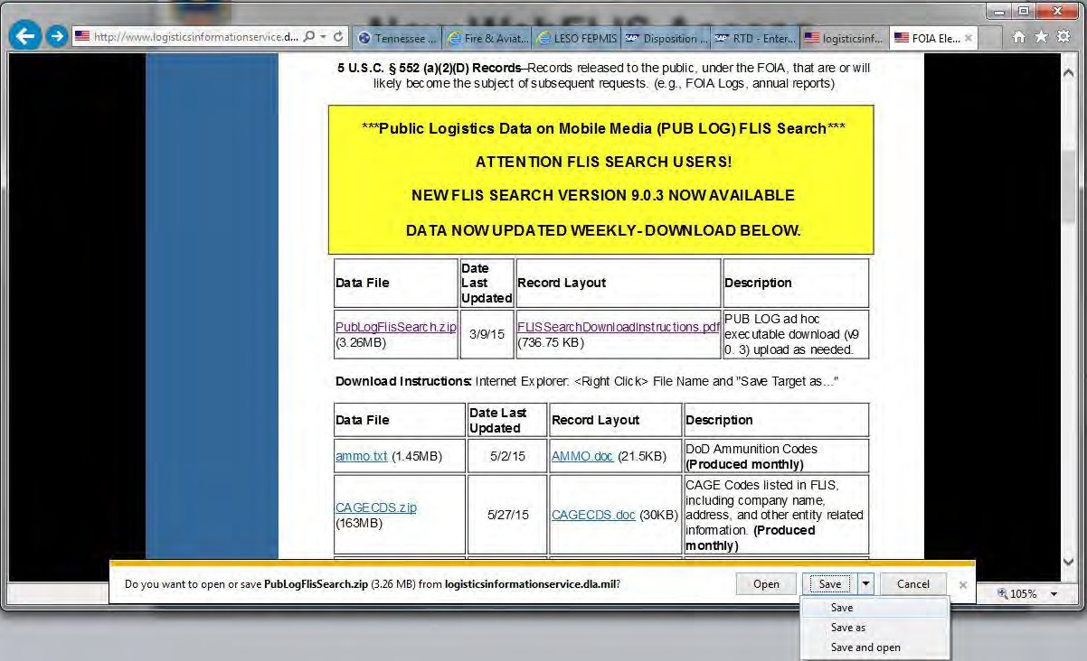
New WebFLIS Access
After clicking on the link click on “Save” at the bottom of the page and then click “Save As.”
Deliver the right solution on time, every time

Slide 5
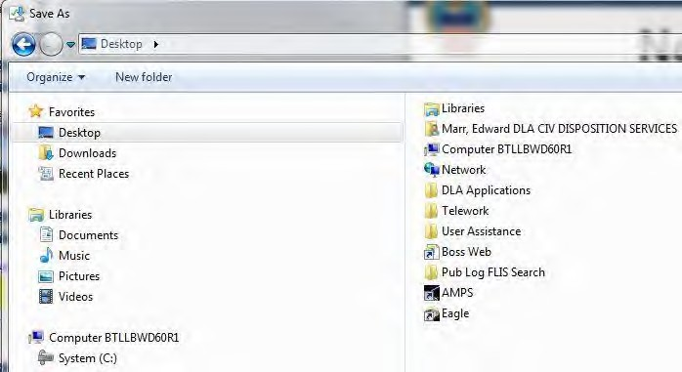
New WebFLIS Access
Save to the Pub Log FLIS Search folder you created
Deliver the right solution on time, every time
1. Click on Desktop
2. Double Click the “Pub LOG FLIS Search” Folder

Slide 6
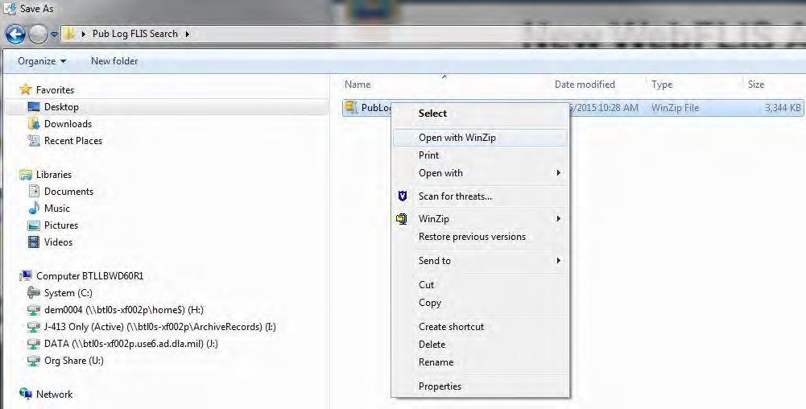
New WebFLIS Access
Opening the file
Deliver the right solution on time, every time
To open the file Right mouse click on the file and select “Open with WinZip.”

Slide 7
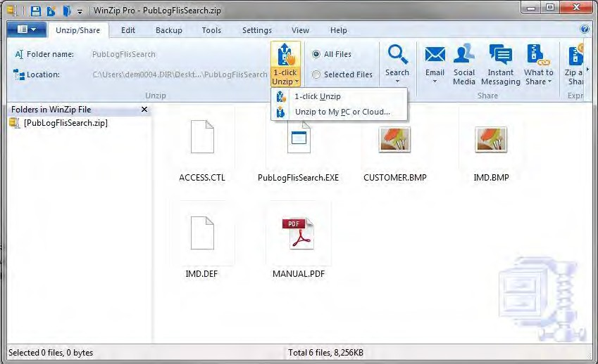
Deliver the right solution on time, every time
New WebFLIS Access
Unzipping the File
Click on “1-Click Unzip” and then 1-Click Unzip” again.

Slide 8
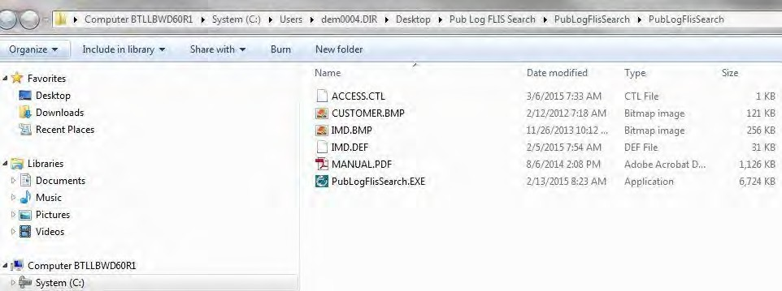
New WebFLIS Access
File that will be saved
Deliver the right solution on time, every time
The following files will be save to your computer.

Slide 9
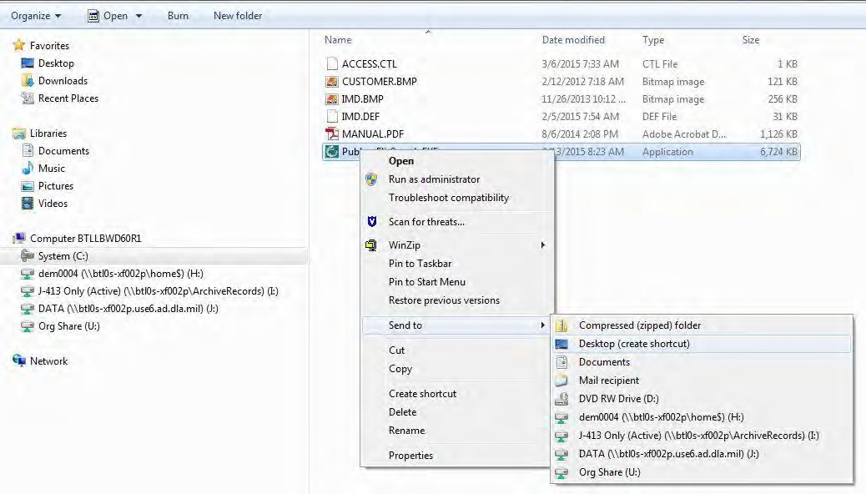
Deliver the right solution on time, every time
New WebFLIS Access
Creating a Short Cut
1. Right click on the “PubLogFLISSearch” file
2. Click on “Send to.”
3. Click on “Desktop (create shortcut)

Slide 10

New WebFLIS Access
Opening your short cut
Deliver the right solution on time, every time
Go to your new short cut on your Desktop and Double click on the ICON.
10

Slide 11
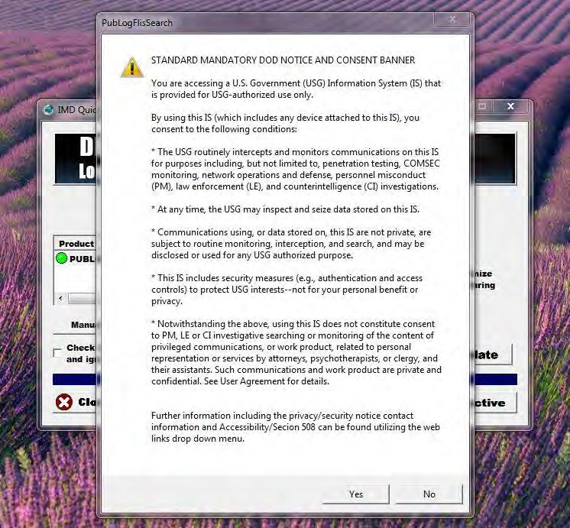
New WebFLIS Access
Consent Banner
Deliver the right solution on time, every time
Select Yes

Slide 12
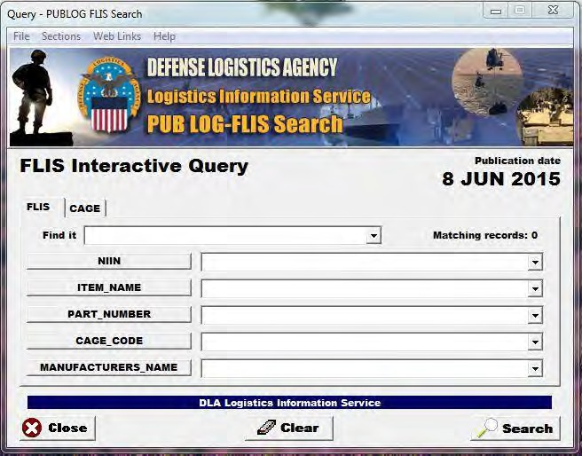
New WebFLIS Access
Start using the New WebFLIS
Deliver the right solution on time, every time
If you have any questions please call 800-532-9946
12

Slide 13

DEFENSE LOGISTICS AGENCY
AMERICA’S COMBAT LOGISTICS SUPPORT AGENCY

